Slide 1
Report on the 5th IUPAP International Conference on Women in Physics
(Conference Supported by IUPAP Working Group on Women in Physics)
Beth A. Cunningham, AAPT
Cherrill Spencer, ex-SLAC National Accel. Lab
Anne Cox, Eckerd College

Slide 2
Overview
Beth
Past International Conferences on Women in Physics
Format of ICWIP-2014
US Delegation, Country Paper & Country Poster
Cherrill
Keynote and Plenary Sessions
My STEM Story
Career Panel
Country strategies
Anne
Resolutions
Video

Slide 3
History of International Conference on Women in Physics
2002 – Paris, France (12 US Delegates, 1 Team Leader)
2005 – Rio de Janeiro, Brazil (19 US Delegates, 2 Team Leaders)
2008 – Seoul, Korea (29 US Delegates, 3 Team Leaders)
2011 – Stellenbosch, South Africa (24 US Delegates, 4 Team Leaders)

Slide 4
5th International Conference on Women in Physics http://icwip2014.wlu.ca/index.php
August 5-8, 2014
Wilfrid Laurier University, Waterloo, Canada
Features:
Plenary Talks (including Melissa Franklin, Harvard)
Workshops
Poster presentations (country posters, participant research posters)
Outreach sponsored by Perimeter Institute and Laurier Center for Women in Science
Networking and social activities

Slide 5
Special Outreach Activity “My STEM Story”
“We invite you to share a story that reflects your life in physics.”
Conveys an experience or perspective that has shaped the scientist and person you have become
Shared via unique and engaging compilation during the conference and on a website
Sponsored by Perimeter Institute

Slide 6
General Information about Conference Participants
Number of Countries: 49
From most continents
Ranging from Albania to Zambia
Number of Participants: 215
Mostly women
Some challenges with visas

Slide 7
Proceedings of the ICWIP-2014
Plenary Sessions Papers
Summaries of Workshops
Country Papers
48 submitted
Scientific Papers
34 submitted
Peer review process
Topics: nuclear, elementary particle, condensed matter, electromagnetism, geophysics, physics education and women in physics
Expected publication: late spring 2015 (open access)

Slide 8
Collaborative Process to Determine Team Leaders
AAPT, APS, AIP, and SPS
Team Leaders:
Anne Cox, Eckerd College
Elaine Lalanne, NAVAIR (US Naval Air Systems Command)
Susan Seestrom, Los Alamos National Lab
Sherry Yennello, Texas A&M University
Beth Cunningham, AAPT

Slide 9
US Delegation to 5ICWIP http://www.uswip.org
11 travelers (including 5 Team Leaders):
2 students
2 national lab and government facility
6 college/university faculty (from liberal art to research university)
1 physics professional society
8 non-travelers
Applicants invited to be on the delegation as non-travelers
Additional US representatives:
AIP (evaluator), SPS (video project), AAPT (proceedings assistance)

Slide 10
US Delegation

Slide 11
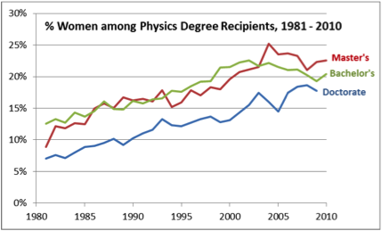
US Country Paper and Poster
AIP Statistical Research Center
Notes:
The fraction of female physics degree earners has leveled off in the past five years, although the number of degree earners is increasing.

Slide 12
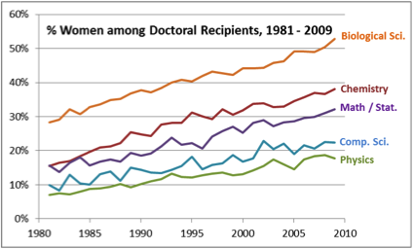
US Country Paper and Poster
AIP Statistical Research Center
Notes:
The fraction of female physics PhD earners is well below those of biology and chemistry.

Slide 13
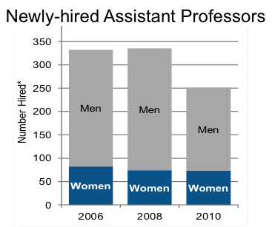
US Country Paper and Poster
AIP Statistical Research Center
Notes:
Although overall hiring is down, the number of new female assistant professors has remained approximately constant since 2006.

Slide 14
US Country Paper and Poster
Concentrated on describing programs and activities to encourage females to choose a career in physics:
Expanding Your Horizons
White House Council on Women & Girls
Created by President Obama in 2009
Workplace flexibility (NSF and NIH programs)
Fact sheets
Mentoring Programs

Slide 15
US Country Paper and Poster
Conferences for Undergraduate Women in Physics
Three-day regional conferences for undergraduate physics majors.
2008 – one site and 29 participants
2014 – eight sites and 1100 participants (about 25% of female undergrad physics majors in the US)
Networking and meeting other female physicists to combat isolation.
Provide information on graduate school, careers in physics, research, women in physics, lab tours, and a student poster session.

Slide 16
US Country Paper and Poster
NSF ADVANCE Grants:
Interdisciplinary (all STEM fields) program to advance the careers of women in science and engineering in higher education
Since 2001, US$135 million for over 100 projects
Supported initiatives include:
formalized mentoring programs
gender equity studies
speaker series
studies of strategies to recruit, retain, and support leadership development

Slide 17
US Country Paper and Poster
Physics Education Research and Gender Issues:
why female students choose to study or pursue careers in physics
how to help them be successful, including self-efficacy, physics identity, psychological interventions, classroom dynamics, pedagogical strategies, and other factors

Slide 18
US Country Paper and Poster
Professional Skills Development Workshops for Women Faculty:
Held at national meetings of AAPT and APS
Provide professional development and support in navigating careers in physics
Information on:
gender differences in views on competition
strategies for engaging in successful negotiations
suggestions for dealing with difficult people in the workplace.

Slide 19
US Country Paper and Poster
Mass Media
“Why are there still so few women in science?,” New York Times, October 2013
“Why Aren't More Girls Attracted To Physics? Girls are more likely to take high school physics if they see women in their communities working in science, technology, engineering and math, a new study finds” National Public Radio, August 2013
“We Know Physics is Largely White and Male, But Exactly How White and Male is Still Striking” Smithsonian.com, July 14, 2014

Slide 20
Activities of US Delegation
Post conference activities
How do we continue the discussion, networking, etc. after the conference
US delegation connecting quarterly via videoconference
Dissemination of information and HerStories video at conferences, colloquia, etc
APS April meeting and AAPT WM15
Local meetings
Articles/Blogs (Anne’s in Scientific American Diversity Blog)
Summer intern (Eckerd/AAPT) to develop outreach and lesson plans based on HerStories interviews

Slide 21
Questions?

Slide 22
Team Leader Responsibilities
Developing the US Delegation
Leading pre- and post conference activities
Fundraising:
NSF and other grant proposals
Private foundations, physics departments, individual contributions
Preparing the poster abstract, paper, and poster on US activity (with help from entire US delegation)

Slide 23
NSF Grant
Travel support for:
US Delegation
Melissa Franklin (invited speaker)
Rachel Ivie (or her designee) – Global Survey/Evaluator
Renee Horton (US rep on Working Group)
Sponsor poster session
Proceedings (open access) and Technical Editor (co-editors: Beth Cunningham, AAPT, Cathy O’Riordan, AIP, and Shohini Ghose, Wilfred Laurier University)
Country or regional level analysis of Global Survey
Captioning (for hearing impaired participants)
Creation of “Her-Story” videos of participants

